Slide 1
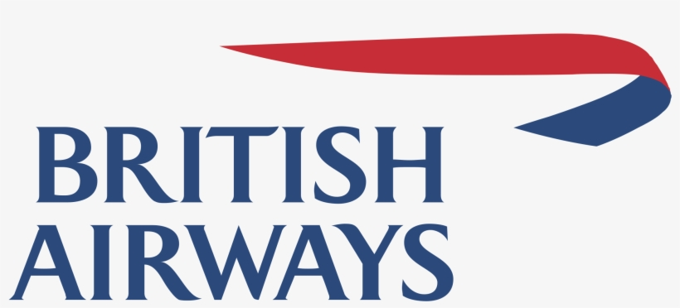
WEB SCRAPING AND ANALYSIS OF BRITISH AIRWAYS REVIEWS DATASET

Slide 2
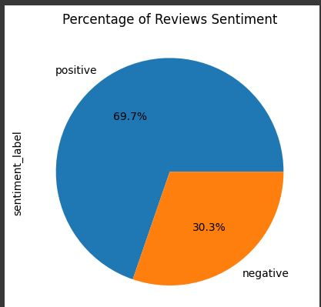
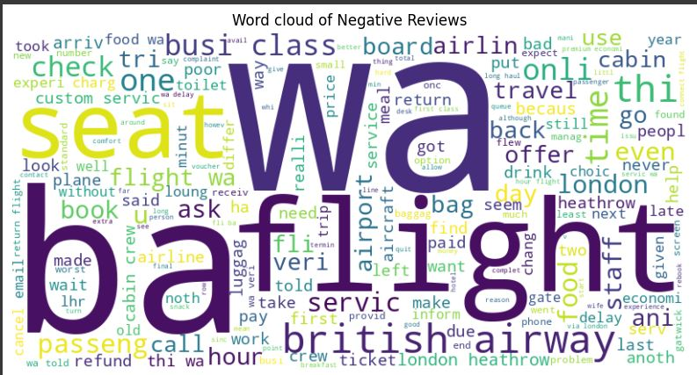
RESULT OF FINDINGS
A Total of 3000 reviews was scrapped from the website.
Textblob Polarity score was used to extract sentiments from each reviews
The analysis shows that 30.3% of the total reviews scrapped are negative reviews..
Here is a wordcloud showing most frequent words used associated with the negative reviews. It shows clearly that customers complained more about the flight, seat, business class amongst others.

